Slide 1
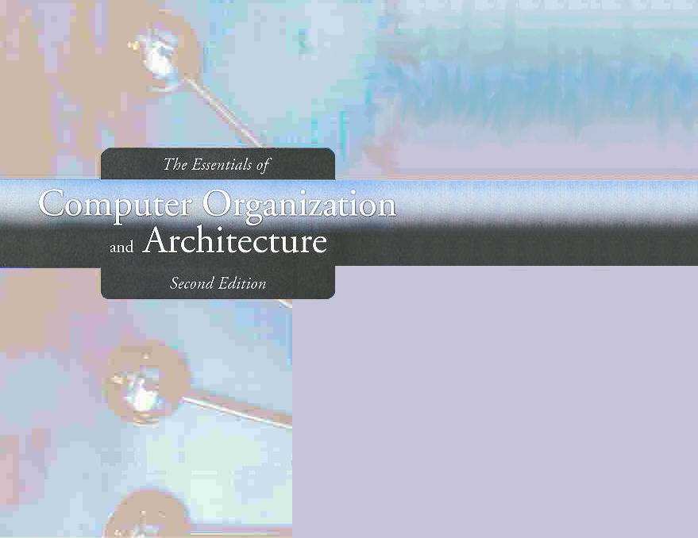
Advanced Architectures
RISC versus CISC Technologies
Flynn’s taxonomy for multiple processor architecture

Slide 2
RISC versus CISC
Learn the properties that often distinguish RISC from CISC architectures.
RISC = Reduced Instruction Set computer
CISC = Complex Instruction Set Computer

Slide 3
RISC Machines: Definition and Difference from CISC
The underlying philosophy of RISC machines
It is better able to manage program execution when the program consists of only a few different instructions that are the same length and require the same number of clock cycles to decode and execute.
In CISC systems, many different kinds of instructions access memory, making instruction length variable and fetch-decode-execute time unpredictable.
RISC systems access memory only with explicit load and store instructions.

Slide 4
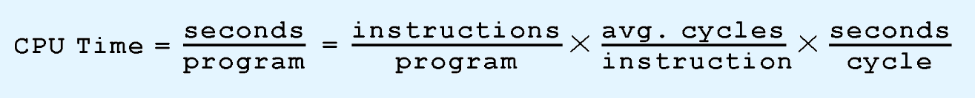
RISC Machines: Strategy to Enhancing Computing Performance
The difference between CISC and RISC becomes evident through the basic computer performance equation:
RISC systems shorten execution time by reducing the clock cycles per instruction.
CISC systems improve performance by reducing the number of instructions per program.
Notes:
RISC machine can be implemented using hardwired which requires less transistors, less space,and suit the pipelining
For CICS, the microcode is used. Even though it is compact and efficient, the variable length instructions which slow the decoding process, and a varying number of clock cycles per instruction which makes it difficult to implement instruction pipelines.

Slide 5
RISC Machines: Enable hardwired control units
The simple instruction set of RISC machines enables control units to be hardwired for maximum speed.
The more complex and variable length instruction set of CISC machines requires microcode-based control units that interpret instructions as they are fetched from memory. This translation takes time.
Only around 20% of all instructions are used most of the time in CISC
With fixed-length instructions, RISC lends itself to pipelining and speculative execution.
Notes:
Only around 20% of all instructions are used most of the time in CISC

Slide 6
RISC Machines: Less clocks per instruction
Consider the the program fragments:
The total clock cycles for the CISC version might be:
(2 movs × 1 cycle) + (1 mul × 30 cycles) = 32 cycles
While the clock cycles for the RISC version is:
(3 movs × 1 cycle) + (5 adds × 1 cycle) + (5 loops × 1 cycle) = 13 cycles
With RISC clock cycle being shorter, RISC gives us much faster execution speeds.
CISC
mov ax, 10
mov bx, 5
mul bx, ax
RISC
mov ax, 0
mov bx, 10
mov cx, 5
Begin add ax, bx
loop Begin
Notes:
Causes a loop cx times
A multiplication on an Intel 8088 requires 133 clock cycles for two 16-bit numbers.
Further more, usually the clock cycle of RISC are shorter than CISC clock cycles.

Slide 7
RISC Machines: LOAD-STORE ISAs
Because of their load-store ISAs, RISC architectures require a large number of CPU registers.
These register provide fast access to data during sequential program execution.
They can also be employed to reduce the overhead typically caused by passing parameters to subprograms.
Instead of pulling parameters off of a stack, the subprogram is directed to use a subset of registers.

Slide 8
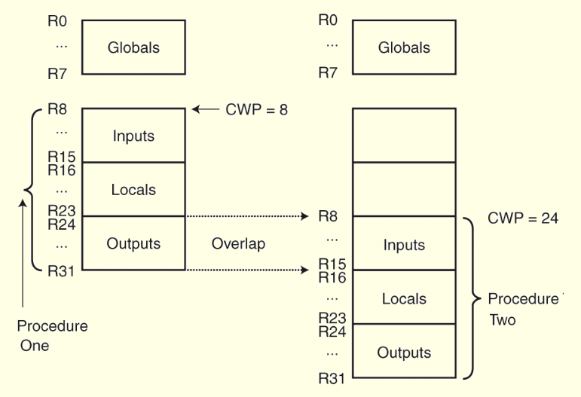
Overlapping Register Windows in RISC Machine
This is how registers can be overlapped in a RISC system.
The current window pointer (CWP) points to the active register window.
There might virtually have, e.g. 24 set of 32 registers each.
Notes:
For a high degrees of nesting in RISC, the set of registers may be recycled.

Slide 9
RISC Machines: Converging with CISC
It is becoming increasingly difficult to distinguish RISC architectures from CISC architectures.
Some RISC systems provide more extravagant instruction sets than some CISC systems.
The RISC PowerPC has a lager ISA than the CISC Pentium
Register usage and Load/Store architecture is more prominent
Some systems combine both approaches.

Slide 10
RISC Machines: Comparisons
RISC
Multiple register sets.
Three operands per instruction.
Parameter passing through register windows.
Single-cycle instructions.
Hardwired
control.
Highly pipelined.
CISC
Single register set.
One or two register operands per instruction.
Parameter passing through memory.
Multiple cycle instructions.
Microprogrammed control.
Less pipelined.
Continued....

Slide 11
RISC Machines
RISC
Simple instructions, few in number.
Fixed length instructions.
Complexity in compiler.
Only LOAD/STORE instructions access memory.
Few addressing modes.
CISC
Many complex instructions.
Variable length instructions.
Complexity in microcode.
Many instructions can access memory.
Many addressing modes.

Slide 12
Parallel processing

Slide 13
Flynn’s Taxonomy
Many attempts have been made to come up with a way to categorize computer architectures.
Flynn’s Taxonomy has been the most enduring of these, despite having some limitations.
Flynn’s Taxonomy takes into consideration the number of processors and the number of data paths incorporated into an architecture.
A machine can have one or many processors that operate on one or many data streams.

Slide 14
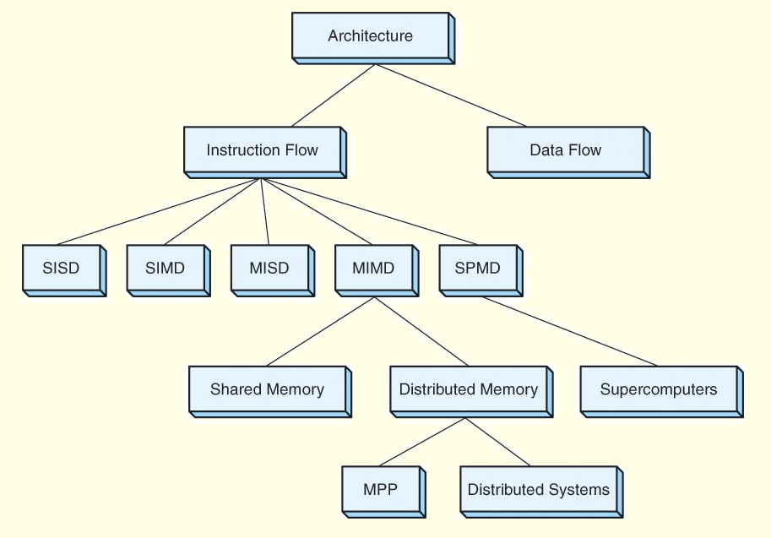
Flynn’s Taxonomy
Notes:
SPMD– Single Program (or process), Multiple Data
MPP– Massively Parallell Processors: lots of super-computers coupled by broad-band networks

Slide 15
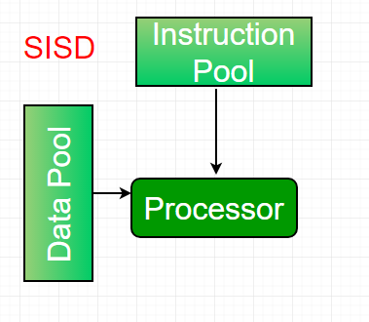
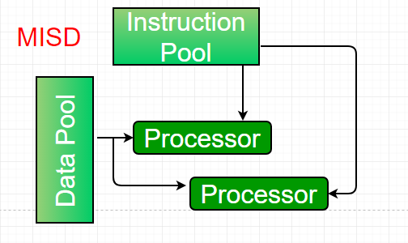
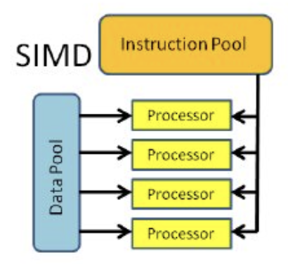
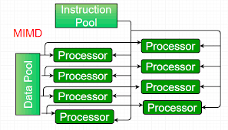
Flynn’s Taxonomy
The four combinations of multiple processors and multiple data paths are described by Flynn as:
SISD: Single instruction stream, single data stream. These are classic uniprocessor systems.
MISD: Multiple instruction streams, single data stream. → Rare architecture.
- SIMD: Single instruction stream, multiple data streams. Execute the same instruction on multiple data values, as in vector processors.
- MIMD: Multiple instruction streams, multiple data streams. These are today’s parallel architectures.

Slide 16
Flynn’s Taxonomy: The Fall Shorts
Flynn’s Taxonomy falls short in a number of ways:
First, there appears to be no need for MISD machines.
Second, parallelism is not homogeneous. This assumption ignores the contribution of specialized processors.
E.g. a separate floating-point adders/multipliers, integer units, etc.
Third, it provides no straightforward way to distinguish architectures of the MIMD category.
One idea is to divide these systems into those that share memory, and those that don’t, as well as whether the interconnections are bus-based or switch-based.

Slide 17
Flynn’s Taxonomy: Extended MIMD for SMP vs MPP
Symmetric multiprocessors (SMP) and massively parallel processors (MPP) are MIMD architectures that differ in how they use memory.
SMP systems share the same memory and MPP do not.
An easy way to distinguish SMP from MPP is:
MPP ⇒ many processors + distributed memory + communication via network
SMP ⇒ fewer processors + shared memory + communication via memory (e.g. variables)

Slide 18
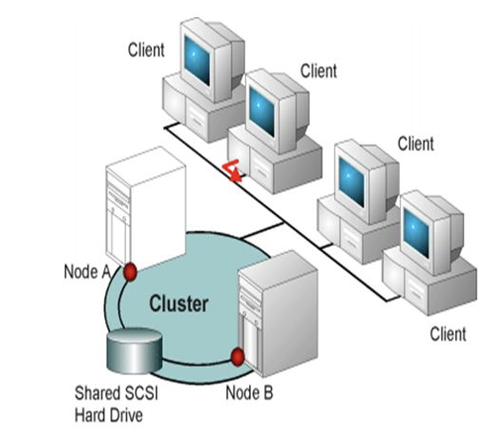
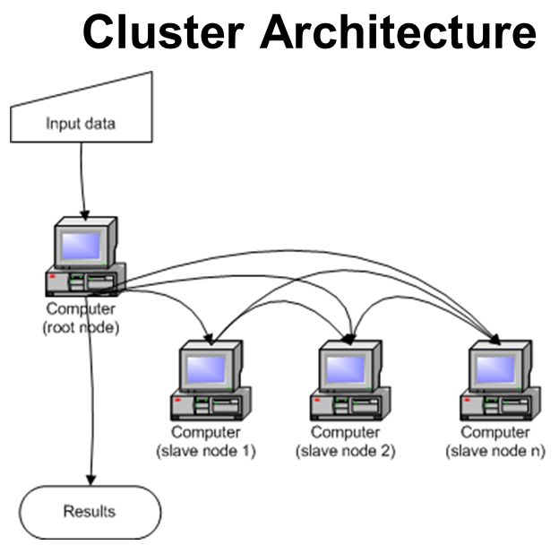
9.3 Flynn’s Taxonomy: MIMD- Distributed Computing
Other examples of MIMD architectures are found in distributed computing, where processing takes place collaboratively among networked computers.
A network of workstations (NOW) uses otherwise idle systems to solve a problem.
- A collection of workstations (COW) is a NOW where one workstation coordinates the actions of the others.
- A dedicated cluster parallel computer (DCPC) is a group of workstations brought together to solve a specific problem.
- A pile of PCs (POPC) is a cluster of (usually) heterogeneous systems that form a dedicated parallel system.
18
Notes:
18

Slide 19
Parallel and Multiprocessor Architectures
Parallel processing is capable of:
Economically increasing system throughput
Providing better fault tolerance.
The limiting factor is that no matter how well an algorithm is parallelized, there is always some portion that must be done sequentially.
keep in mind that an n-fold increase in processing power does not necessarily result in an n-fold increase in throughput

Slide 20
Super-pipelining
Recall →
pipelining divides the fetch-decode-execute cycle into smaller stages that carry out a small part of the process on a set of instructions.
an instruction exits the pipeline during each tick of the clock, idealistically.
Superpipelining → a pipeline has stages that require less than half a clock cycle to complete.
We equip the pipeline with a separate clock
Superpipelining is only one aspect of superscalar design (e.g. IBM’s PowerPC, Sun’s UltraSparc, DEC’s Alpha.)
Notes:
Sample of superscalar architecture in real world = IBM’s PowerPC, Sun’s UltraSparc, DEC’s Alpha

Slide 21
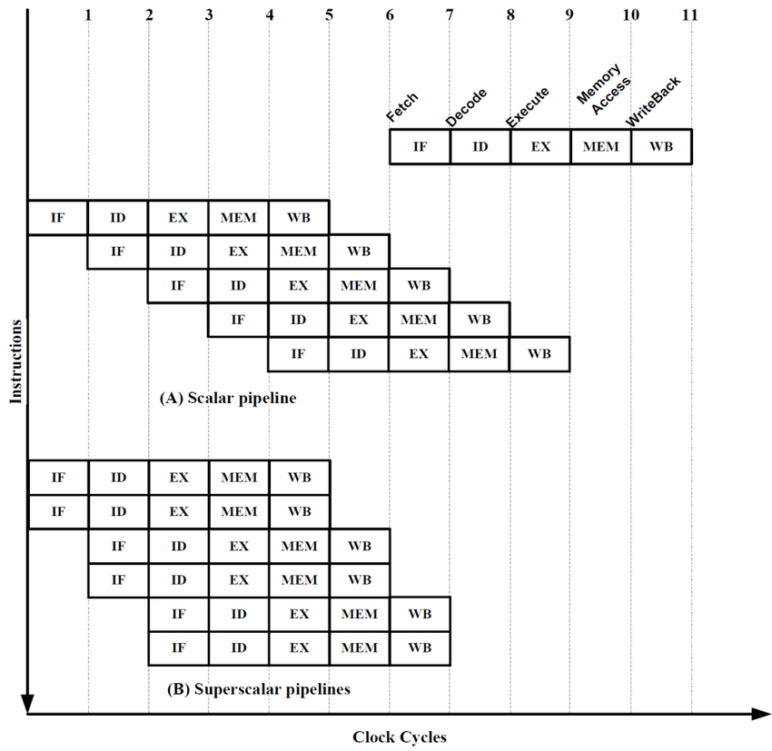
Super scalar architecture
Integrates multiple execution units, e.g. specialized integer and floating-point adders and multipliers.
A critical component is the instruction fetch unit,
Able to simultaneously retrieve several instructions from memory.
A decoding unit determines which of these instructions can be executed in parallel and combines them accordingly.
compilers that make optimum use of the hardware is required.

Slide 22
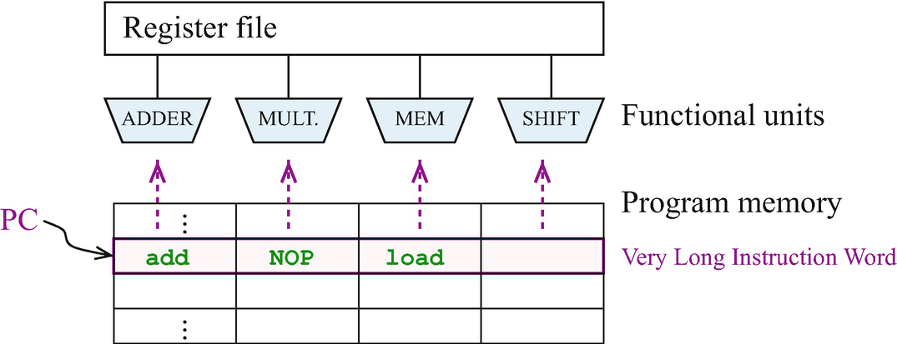
Very Long Instruction Word (VLIW)
VLIW architecture relies on compiler to pack independent instructions into one long instruction that is sent down the pipeline to the execution units, instead of a hardware decoding unit as done in SuperScalar.
Pros and Cons
Pro: Compiler can better identify instruction dependencies.
Con: Compilers tend to be conservative and cannot have a view of the run time code.

Slide 23
Vector computers
http://en.wikipedia.org/wiki/Vector_processor
Vector computers are processors that operate on entire vectors or matrices at once.
These systems are often called supercomputers.
Vector computers are highly pipelined so that arithmetic instructions can be overlapped.
Vector processors can be categorized according to how operands are accessed.
Register-register vector processors require all operands to be in registers.
Memory-memory vector processors allow operands to be sent from memory directly to the arithmetic units.
https://www.geeksforgeeks.org/vector-processor-classification/

Slide 24
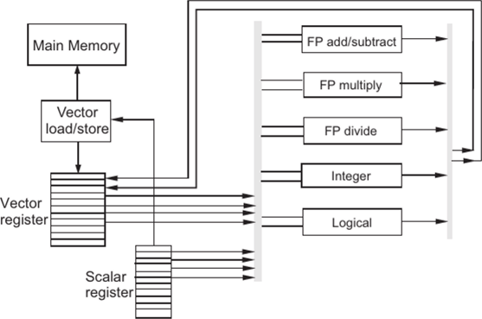
Vector computers (cont.)
By presuming a continuous stream of data, vector machines are efficient
Fewer instructions to fetch,
Values can be prefetched
Disadvantage of vector computer:
Register-register vector computers: large vectors must be broken into fixed-length segments so they will fit into the register sets.
Memory-memory vector computers have a longer startup time before the pipeline becomes full.

Slide 25
MIMD– Classification of System Interconnection
MIMD systems can communicate through shared memory or through an interconnection network (distributed systems).
Interconnection networks are often classified according to their topology, routing strategy, and switching technique.
Of these, the topology is a major determining factor in the overhead cost of message passing.
Message passing takes time owing to network latency and incurs overhead in the processors.

Slide 26
MIMD– Classification of System Interconnection
Interconnection networks can be either static or dynamic.
Processor-to-memory connections usually employ dynamic interconnections. These can be blocking or nonblocking.
Nonblocking interconnections allow connections to occur simultaneously.
E.g. Cross-bar architecture
Example for blocking interconnection is switch
Processor-to-processor message-passing interconnections are usually static, and can employ any of several different topologies, as shown on the following slide.

Slide 27
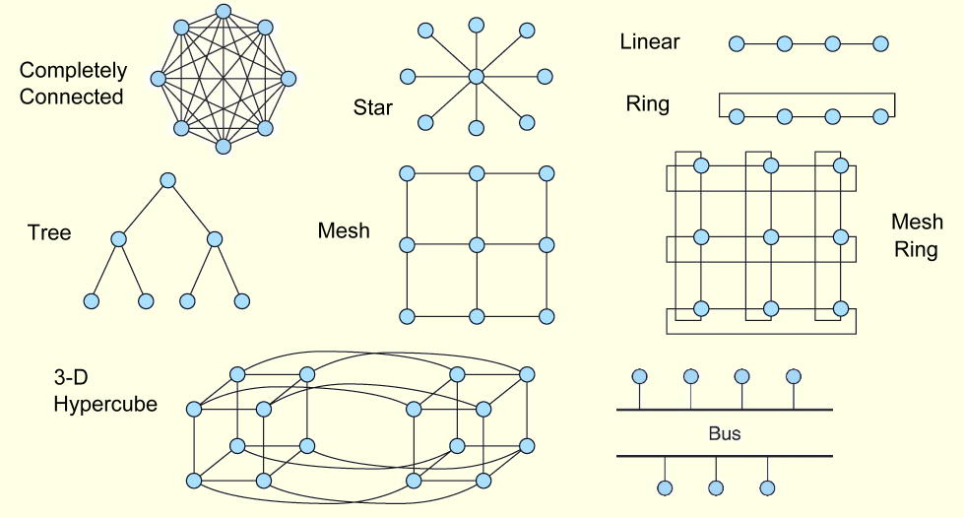
MIMD: Possible Static Interconnection

Slide 28
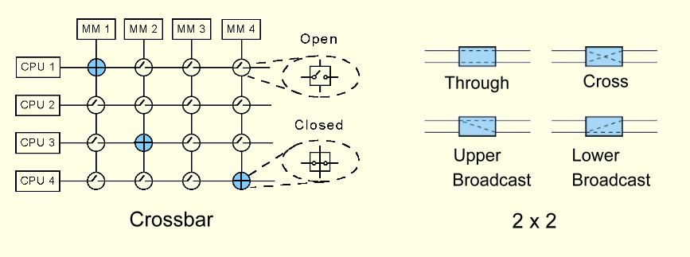
MIMD– Dynamic interconnection
Example dynamic routing is achieved through switching networks that consist of crossbar switches or 2 × 2 switches.

Slide 29
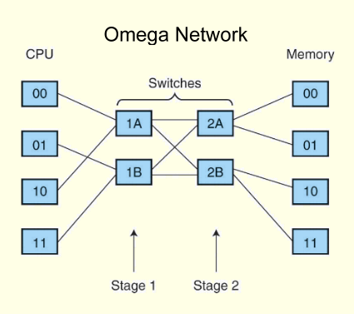
MIMD– Dynamic interconnection
Multistage interconnection (or shuffle) networks are the most advanced class of switching networks.
•
They can be used in loosely-coupled distributed systems, or in tightly-coupled processor-to-memory configurations.
Notes:
The network in this slide is called Omega network (only one state a time is allowed). To move through or cross in each switch, use the logic of 0 = up, 1 = down, so for 00 -> 01, 1st switch (1A) manages 0-0, 1A have a through on up-up and lead signal to 2A and switch 2A manages 0-1, the up-down cross is performed inside this switch.

Slide 30
Pros and Cons of each switching approach
There are advantages and disadvantages to each switching approach.
Bus-based networks:
Economical but can be bottlenecks.
Parallel buses can alleviate bottlenecks, but are costly.
Crossbar networks
Nonblocking network but require n² switches to connect n entities.
Omega networks
Blocking, but exhibit less contention than bus-based networks.
Cheaper than crossbar, n nodes needing log₂n stages with n / 2 switches per stage.

Slide 31
MIMD– Distributed Shared Memory Multiprocessors
Tightly-coupled multiprocessor systems use the same memory. They are also referred to as shared memory multiprocessors.
The processors do not necessarily have to share the same block of physical memory:
Each processor can have its own memory, but it must share it with the other processors.
Configurations such as these are called distributed shared memory multiprocessors.

Slide 32
distributed shared memory multiprocessors
Shared Memory MIMD machines
Non-uniform memory access (NUMA) --
Uniform memory access (UMA) --all memory access take the same amount of time
The interconnection network must be fast enough to support multiple concurrent accesses to memory, or it will slow down the whole system.
Thus, the interconnection network limits the number of processors in a UMA system.
see memory as one contiguous addressable space, each processor gets its own piece of it
a processor can access its own memory much more quickly.
Not only does each processor have its own memory, it also has its own cache, a configuration that can lead to cache coherence problems

Slide 33
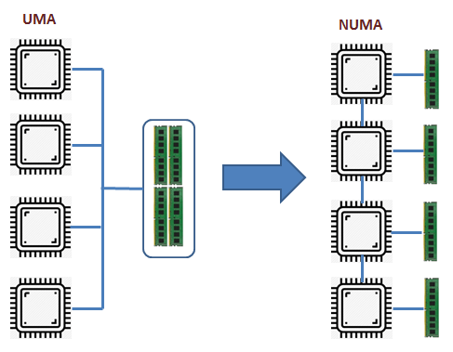
MIMD– Shared memory
Cache coherence problems arise when main memory data is changed and the cached image is not. (We say that the cached value is stale.)
-To combat this problem,
some NUMA machines are equipped with snoopy cache controllers that monitor all caches on the systems. These systems are called cache coherent NUMA (CC-NUMA) architectures.
A simpler approach is to ask the processor having the stale value to either void the stale cached value or to update it with the new value.

Slide 34
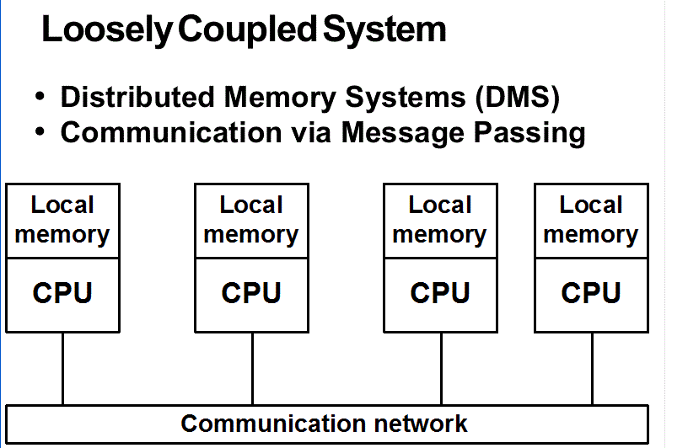
Distributed Computing
Distributed computing is another form of multiprocessing. However, the term distributed computing means different things to different people.
In a sense, all multiprocessor systems are distributed systems because the processing load is distributed among processors that work collaboratively.
The common understanding is that a distributed system consists of very loosely-coupled processing units.
Recently, Networks of Workstations (NOWs) have been used as distributed systems to solve large, intractable problems.

Slide 35
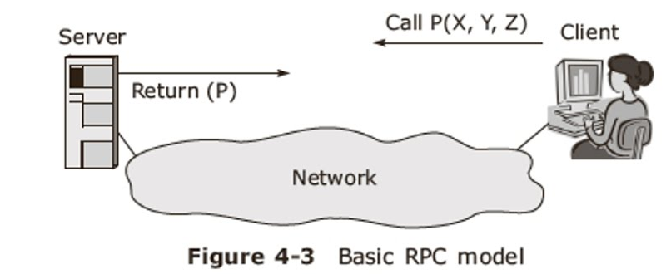
Parallel in general computing
For general-use computing,
→the details of the network and the nature of the multiplatform computing should be transparent to the users of the system.
Remote procedure calls (RPCs) enable this transparency.
RPCs use resources on remote machines by invoking procedures that reside and are executed on the remote machines.
Currently, the XML-RPC, Websocket and REST (web-services) are taking place of the traditional RPCs.

Slide 36
9.4 Parallel and Multiprocessor Architectures
Cloud computing is distributed computing to the extreme.
It provides services over the Internet through a collection of loosely-coupled systems.
In theory, the service consumer has no awareness of the hardware, or even its location.
Your services and data may even be located on the same physical system as that of your business competitor.
The hardware might even be located in another country.
Security concerns are a major inhibiting factor for cloud computing.
36
Notes:
36

Slide 37
Chapter 9 Conclusion
The common distinctions between RISC and CISC systems include RISC’s short, fixed-length instructions. RISC ISAs are load-store architectures. These things permit RISC systems to be highly pipelined.
Flynn’s Taxonomy provides a way to classify multiprocessor systems based upon the number of processors and data streams. It falls short of being an accurate depiction of today’s systems.
37
Notes:
37

Slide 38
Chapter 9 Conclusion
Massively parallel processors have many processors, distributed memory, and computational elements communicate through a network. Symmetric multiprocessors have fewer processors and communicate through shared memory.
Characteristics of superscalar design include superpipelining, and specialized instruction fetch and decoding units.
38
Notes:
38

Slide 39
Chapter 9 Conclusion
Very long instruction word (VLIW) architectures differ from superscalar architectures because the compiler, instead of a decoding unit, creates long instructions.
Vector computers are highly-pipelined processors that operate on entire vectors or matrices at once.
MIMD systems communicate through networks that can be blocking or nonblocking. The network topology often determines throughput.
39
Notes:
39

